Slide 1
Applets
Lecture 9

Slide 2
introduction
Applet is a special type of program that is embedded in the webpage to generate the dynamic content.
Types:
Local : An applet developed locally and stored in a local system is known as a local applet.
Remote : it is developed by someone else and stored on a remote computer connected to the internet. If the system is connected to the internet, then we can download the remote applet on the system via internet and run it.

Slide 3
Preparing to write applet
Building an applet code (.java file)
Creating an executable applet (.class file)
Designing a web page using HTML tags
Preparing <APPLET> tag.
Incorporating <APPLET> tag into web page.
Creating HTML file
testing the applet code.

Slide 4
Building applet code
import java.applet.Applet;
import java.awt.Graphics;
public class First extends Applet
{
public void paint(Graphics g)
{
g.drawString("welcome",150,150);
}
}
save it as First.java

Slide 5
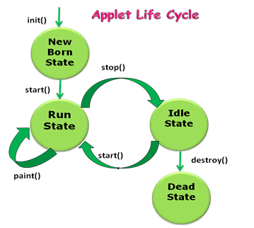
Applet life cycle

Slide 6
Display state
Applet moves to the display state whenever it has to perform some output operations on the screen.
The paint() method is called to accomplish this task.

Slide 7
Creating an executable applet
compile the .java file using javac First.java
The compiled output file called First.class is placed in the same directory as the source.
If any error occurs then check the error and compile again.

Slide 8
Designing a Web Page
Comment section
Head Section
Body Section
Save the html file using .html ext and store in the same directory as the compiled code of the applets.

Slide 9
Applet Tag
<applet> tag supplies the name of the applet to be loaded and tells the browser how much space the applet requires.
<applet code="First.class" width="300" height="300">
</applet>

Slide 10
Adding Applet to the html file
<html>
<head>
<title> Welcome to the JAVA Applet </title>
</head>
<body>
<applet code="First.class" width="300" height="300">
</applet>
</body>
</html>
Name the file as First.html and save it in the same directory.

Slide 11
Running Applet
To run an applet we require one of the following:
Java Enabled Web Browser
Java Appletviewer
appletviewer First.html

Slide 12
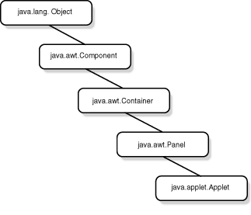
Applet Class

Slide 13
applet tag
CODE= appletFilename.class
CODEBASE=Codebase_url
Width=pixels
Height=pixels
Name= applet_instance_name
Align=alignment
Hspace=pixels
Vspace= pixels
ALT= alternate_text

Slide 14
Passing Parameters to Applet
<applet....>
<param name=“color” value= “red”>
</applet>

Slide 15
Example
import java.applet.Applet;
import java.awt.Graphics;
public class UseParam extends Applet
{
String str;
public void init()
{
str=getParameter(“msg”);
if(str==null)
str=“JAVA”;
str=“HELLO” + str;
}
public void paint(Graphics g)
{
g.drawString(str,50, 50);
}
}

Slide 16
HTML file
<html>
<body>
<applet code="UseParam.class" width="300"
height="300">
<param name="msg" value=“Applet">
</applet>
</body>
</html>

Slide 17
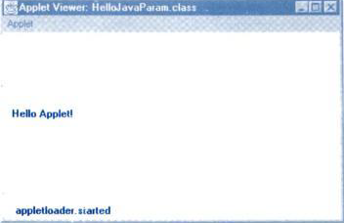
OUTPUT

Slide 18
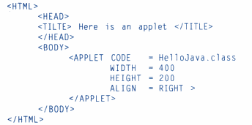
ALIGNING THE DISPLAY
LEFT
RIGHT
TOP
TEXT TOP
MIDDLE
ABSMIDDLE
BASELINE
BOTTOM
ABSBOTTOM

Slide 19
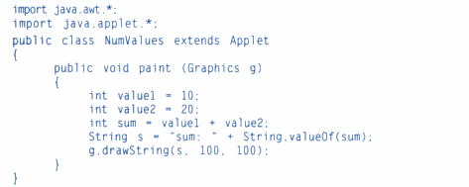
Displaying Numeric value

Slide 20
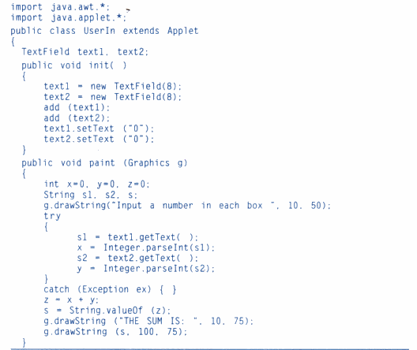
getting input from user

